Slide 1
PIP4004: UNIVERSITY PROJECT Review-0 Presentation
BHASHA BRIDGE
Batch Number: CSE-G02
Under the Supervision of,
Ms. Akkamahadevi
Professor / Associate Professor / Assistant Professor
School of Computer Science and Engineering
Presidency University
Roll Number | Student Name
20211CSE0502 20211CSE0512 20211CSE0523 | Jaideep Singh Dudi Satyam Manu Pathak Ayan Sharma
Name of the Program: CSE
Name of the HoD: Dr.Asif Mohammed H.B
Name of the Program Project Coordinator: Mr. Amarnath J.L & Dr. Jayanthi. K.
Name of the School Project Coordinators: Dr. Sampath A K / Dr. Abdul Khadar A / Mr. Md Ziaur Rahman

Slide 2
Content
Problem Statement
Github Link
Analysis of Problem Statement
Timeline of the Project
References

Slide 3
Problem Statement Number:
Organization : Ministry of Commerce and Industries
Category (Hardware / Software / Both) : Software
Problem Description :
We aim to build a software for translating resource material and other texts from English to other local Indian Languages. According to the Census of India of 2001, India has 122 major languages and 1599 other languages are spoken by the 1.38 billion population of India. According to the Eighth Schedule of the Constitution, twenty-two (22) of them are considered as official languages; viz. Assamese, Bengali, Gujarati, Hindi, Kannada, Kashmiri, Konkani, Malayalam, Manipuri, Marathi, Nepali, Oriya, Punjabi, Sanskrit, Sindhi, Tamil, Telugu, Urdu, Bodo, Santhali, Maithili and Dogri. Translation services are essential for various sectors. As, most people only know one or two languages, translation services assist them in obtaining necessary information in their own tongue by eliminating the language barrier. This solution will be user-friendly, easy to use and understand, can work with multiple dialects, and handle linguistic nuances such as grammar, sentence structure, and cultural context. The software will assist in translation of these texts created in multiple forms: word document, pdf document, text in images etc.
Difficulty Level : Simple

Slide 4
Github Link
The Github link provided should have public access permission.
Github Link
https://github.com/BhasaBridge/BhasaBridge

Slide 5
Analysis of Problem Statement
Technology Stack Components :
This project consists of only software components and implements the following topics :-
Frontend : React.js (Web), Flutter (Mobile)
Backend : FastAPI (Python))
Natural Language Processing and AI Models : Hugging Face Transformers, TensorFlow
Database : PostgreSQL + Firebase
Cloud Services : AWS S3, Google AI Platform
APIs: Google Translate API, IndicNLP Library

Slide 6
Analysis of Problem Statement (contd...)
Database (PostgreSQL + Firebase) – Stores user data, translation history, and language resources for efficient access.
Frontend (React.js for Web, Flutter for Mobile) – Provides an interactive user interface for users to input text, select languages, and view translations.
Backend (FastAPI - Python) – Handles API requests, processes text data, and communicates with AI models and databases.
NLP & AI Models (Hugging Face Transformers, TensorFlow) – Performs language translation using deep learning models trained on multilingual datasets.
Database (PostgreSQL + Firebase) – Stores user data, translation history, and language resources for efficient access.
Cloud Services (AWS S3, Google AI Platform) – Provides scalable storage, model training, and deployment infrastructure.
APIs (Google Translate API, IndicNLP Library) – Enables integration with pre-trained translation models and supports text preprocessing tasks like tokenization and transliteration.

Slide 7
Architecture Diagram
+-------------------+ +-------------------+ +-------------------+
| Login Page | | Input Text Box | | Output Text Box |
+-------------------+ +-------------------+ +-------------------+
| | |
v v v
+-------------------+ +-------------------+ +-------------------+
| Authentication | | Translation Engine| | Text-to-Speech |
| Service | | | | Service |
+-------------------+ +-------------------+ +-------------------+
| | |
v v v
+-------------------+ +-------------------+ +-------------------+
| User Database | | PDF Parser | | Speech-to-Text |
| | | | | Service |
+-------------------+ +-------------------+ +-------------------+
| | |
v v v
+-------------------+ +-------------------+ +-------------------+
| History Storage | | File Storage | | External APIs |
| Service | | | | (Translation, TTS,|
+-------------------+ +-------------------+ | STT) |
| | +-------------------+
v v
+-------------------+ +-------------------+
| Translation | | Translation |
| History Database | | History Database |
+-------------------+ +-------------------+

Slide 8
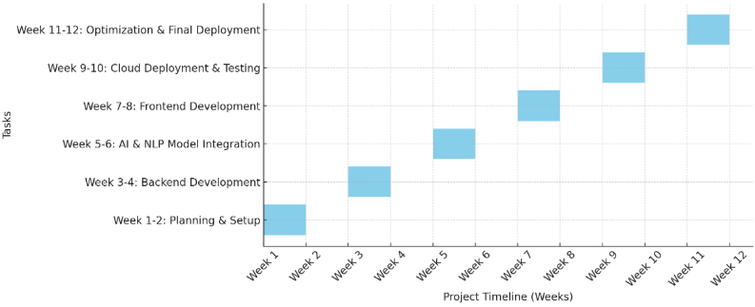
Timeline of the Project (Gantt Chart)

Slide 9
Conclusion
The development of software for translating resource materials and other texts from English to various Indian languages is a crucial step toward enhancing accessibility, inclusivity, and knowledge dissemination. By leveraging advanced AI, machine learning, and natural language processing techniques, this software can bridge linguistic gaps and enable seamless communication across diverse linguistic communities. Ensuring high accuracy, contextual relevance, and ease of use will be essential in making the software a valuable tool for education, business, governance, and more.

Slide 10
References (IEEE Paper format)
[1] Sen, O., Fuad, M., Islam, M. N., Rabbi, J., Masud, M., Hasan, M. K., Awal, M. A., Fime, A. A., Fuad, M. T. H., Sikder, D., & Iftee, M. a. R. (2022). Bangla Natural Language Processing: A Comprehensive analysis of Classical, Machine Learning, and Deep Learning-Based methods. IEEE Access, 10, 38999–39044. https://doi.org/10.1109/access.2022.3165563
[2]B. K. Yazar, D. Ö. Şahın, and E. Kiliç, “Low-Resource Neural Machine Translation: A Systematic Literature review,” IEEE Access, vol. 11, pp. 131775–131813, Jan. 2023, doi: 10.1109/access.2023.3336019
[3]Sethi, N., Dev, A., Bansal, P., Sharma, D. K., & Gupta, D. (2023). Enhancing Low-Resource Sanskrit-Hindi Translation through Deep Learning with Ayurvedic Text. ACM Transactions on Asian and Low-Resource Language Information Processing. https://doi.org/10.1145/3637439
[4] Xin Li; Shuai Gao “Construction of Foreign Language Translation Recognition System Model Based on Artificial Intelligence Algorithms. https://ieeexplore.ieee.org/abstract/document/10548204/authors#authors
[5] Dey, S., Sahidullah, M., & Saha, G. (2022b). An Overview of Indian Spoken Language Recognition from Machine Learning Perspective. ACM Transactions on Asian and Low-Resource Language Information Processing, 21(6), 1–45. https://doi.org/10.1145/3523179
[6] Abdul Ghafoor; Ali Shariq Imran; Sher Muhammad Daudpota; Zenun Kastrati; Abdullah; Rakhi Batra.The Impact of Translating Resource-Rich Datasets to Low-Resource Languages Through Multi-Lingual Text Processing. https://ieeexplore.ieee.org/abstract/document/9529190
[7] A. Stolcke; Barry Chen; H. Franco; Venkata Ramana Rao Gadde; M. Graciarena; Mei-Yuh Hwang Recent innovations in speech-to-text transcription at SRI-ICSI-UW https://ieeexplore.ieee.org/abstract/document/1677992
[8] Jiajun Zhang and Chengqing Zong “Deep Neural Networks in Machine Translation: An Overview”
https://nlpr.ia.ac.cn/cip/ZongPublications/2015/IEEE-Zhang-8-5.pdf
[9] R. Jensen; Q. Shen Semantics-preserving dimensionality reduction: rough and fuzzy-rough-based approaches. https://ieeexplore.ieee.org/abstract/document/1350758
[10] Mai Miyabe; Takashi Yoshino Evaluation of the Validity of Back-Translation as a Method of Assessing the Accuracy of Machine Translation. https://ieeexplore.ieee.org/abstract/document/7433246

Slide 11


